Slide 1

INTERNATIONAL FEDERATION OF CONSULTING ENGINEERS
“RESILIENCE TO NATURAL DISASTERS”
FLOOD CONTROL STRATEGIES
William Howard
FIDIC VICE PRESIDENT
May 9th, 2018

Slide 2
AGENDA
Global Changes
Natural Disasters
Global consequences
Required actions
Prevention
Flood Damage Mitigation
Preparedness

Slide 3
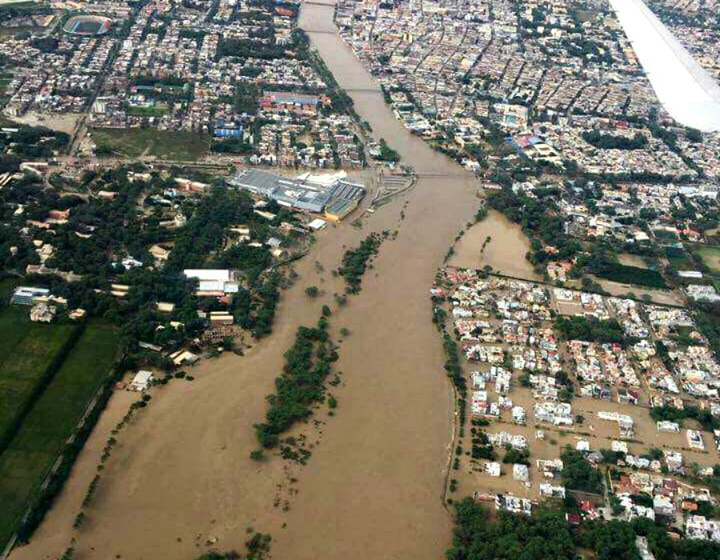
1. Global Changes
OCEANS - WARMING, ACIDIFICATION, SEA LEVEL RISE and POLLUTION
ATMOSPHERIC – CO2 (400PPM+), 2 TO 5 DEGREE AVERAGE TEMPERATURE INCREASE BY 2021?
GLACIER RETREAT (exposing mineralized rock in Peru and acidifying streams)
MORE NATURAL DISASTERS
CLIMATE CHANGE IS REAL

Slide 4
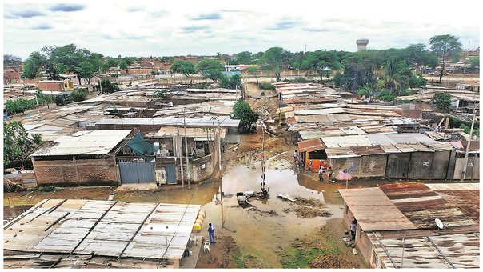
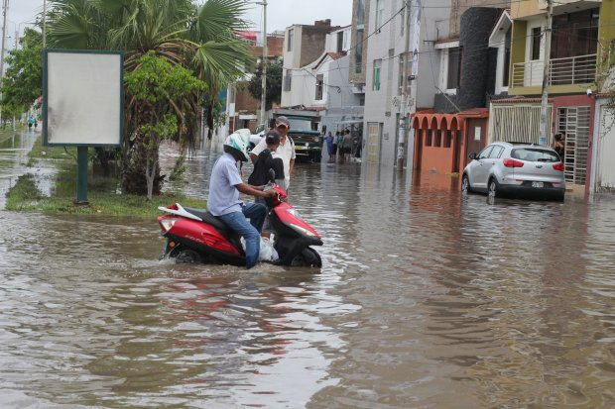
2. Natural Disasters
INTENSE DROUGHTS
INTENSE STORMS (Piura – 2,400 mm of rain in 3 months vs yearly average of 100mm)
DEFORESTATION (a factor in Piura floods)
LANDSLIDES
MUDFLOWS
FLOODS
THE ABOVE SIX DISASTERS ARE ALL RELATED TO EACH OTHER

Slide 5
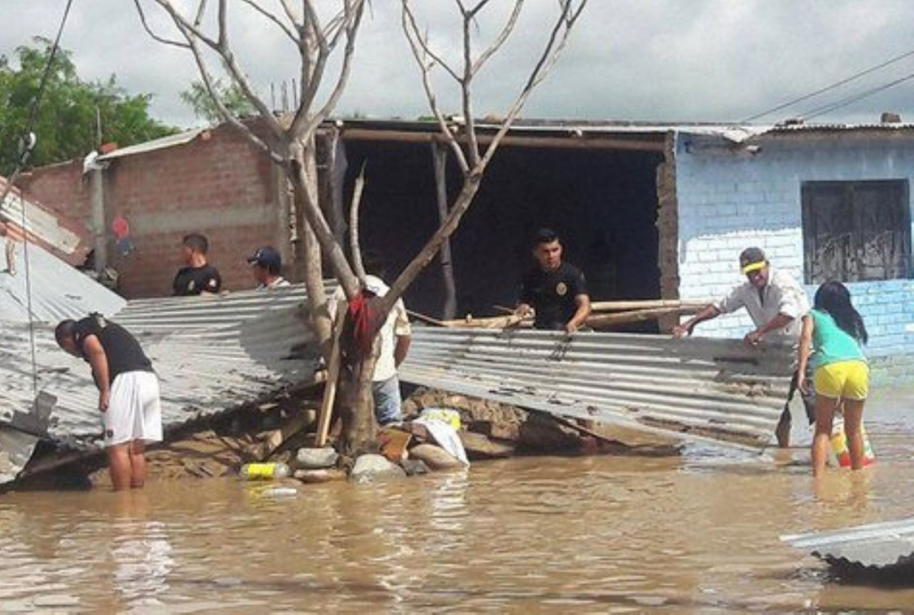
3. Global consequences
POPULATION SHIFTS
LOSS OF LIFE
LOSS OF PROPERTY ($ TRILLIONS)

Slide 6
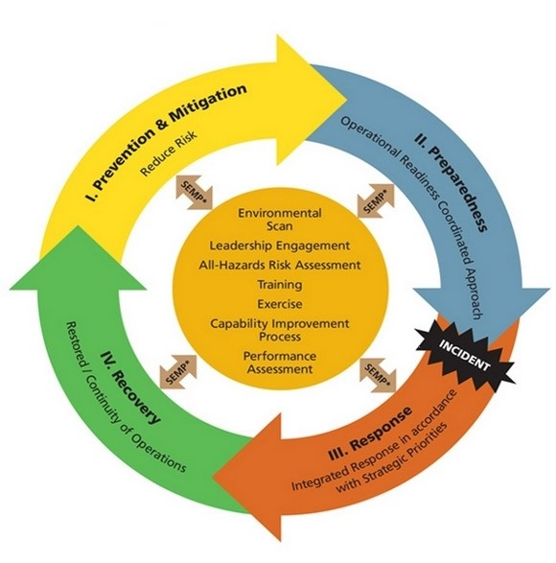
4. Required actions

Slide 7
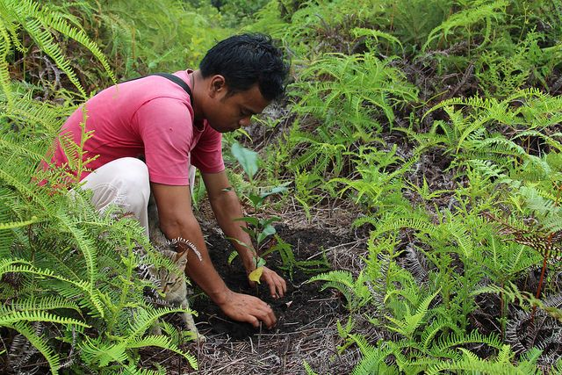
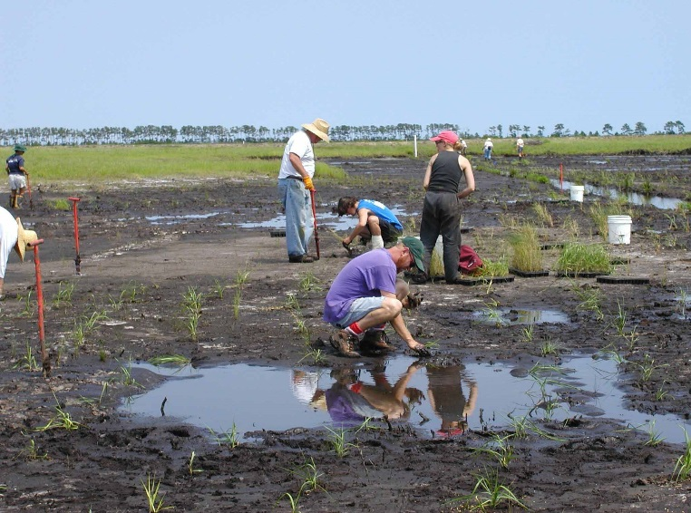
5. Prevention
REDUCE CO2 and OTHER GREEN HOUSE GAS EMISSIONS
LESS USE OF FOSSIL FUELS
CARBON SEQUESTRATION
RESTORE FORESTS and NATURAL LANDSCAPES
RESTORE WETLANDS
SLOPE STABILIZATION
BOTTOM THREE WERE ALL FACTORS IN PIURA FLOODS

Slide 8
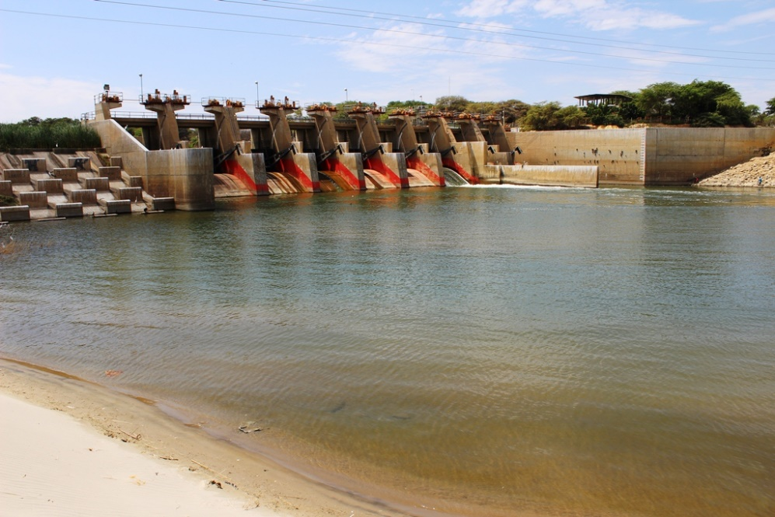
6. Flood damage mitigation
NEW RESERVOIRS (WATER SUPPLY, FLOOD CONTROL, POWER GENERATION, RECREATION)
INCREASING THE CAPACITY OF EXISTING RESERVOIRS (RAISING THE ELEVATION OF DAMS, SILT REMOVAL)
DIKES (NEW and EXISTING) – ALLOW FOR FUTURE HEIGHT INCREASES
DETENTION BASINS
ZONING REVISIONS
HARDENING STRUCTURES
MULTI USE STRUCTURES
HOLISTIC MULTI FUNCTIONAL STORMWATER MANAGEMENT
DESIGN for UNCERTAINTY

Slide 9
7. Preparedness
DEVELOP PREDICTIVE TOOLS (study weather patterns; Piura National Security and Defense Agency monitors ocean temperatures)
USEPA – CREAT TOOL
EARLY WARNING SYSTEMS
EVACUATION PLANS
EDUCATION (awareness is the first step towards problem resolution)
DEVELOP A COMPREHENSIVE DISASTER MANAGEMENT PLAN (US FEMA-GUIDANCE)

Slide 10
THANK YOU

